Slide 1
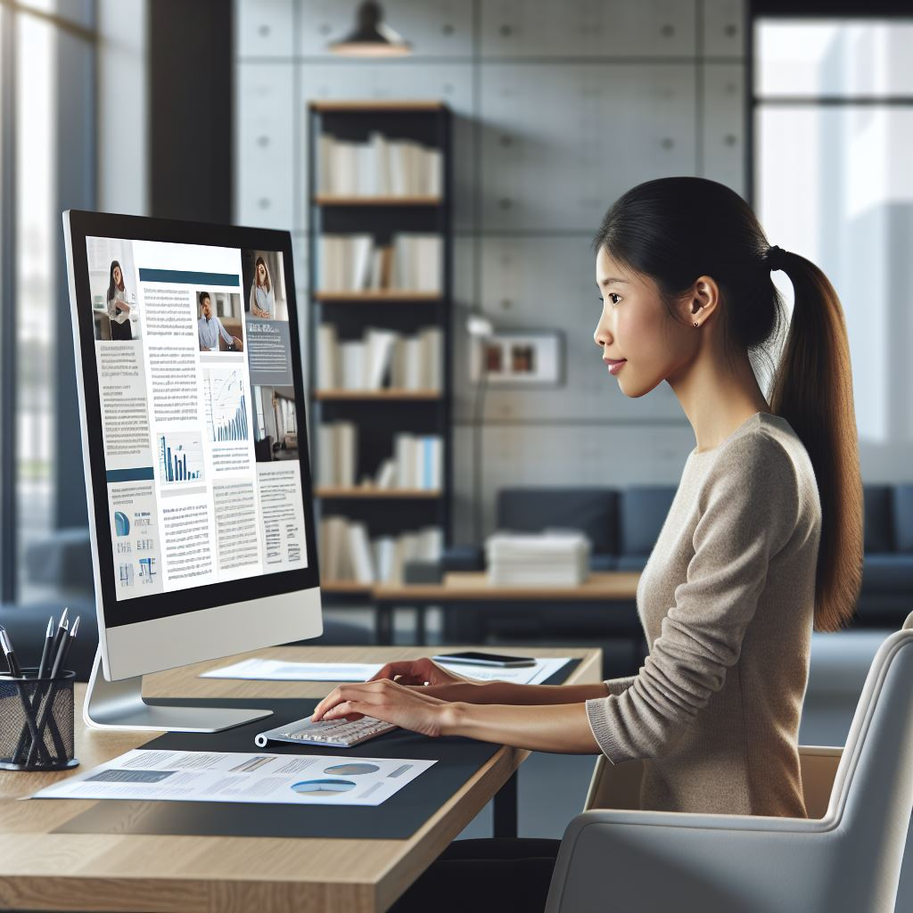


Heading of title: DM Sans Medium, bold, 80 pt,
Subheading: DM Sans, 54 pt
CONCLUSION (Heading of text in the poster: DM Sans, bold, 44 pt)
The purpose of a poster is to get a message across! Grab the reader's interest by starting with the most important thing!
Keep it short. Too much text means that the message gets lost. Try to make sure that the poster gives an airy impression.
Introduction
Many posters are difficult to read. Important results are often hidden in too many words. Don't try to include everything! Be logical - then it is easier to follow the message.
The aim of the poster
Arouse interest, curiosity, and attention. The poster should work as an advertisement and not as a report.
Use images
Using illustrative images can help you capture interest and cut out unnecessary text. If you don't have images, it's definitely worth putting in the extra effort to get them.
Image generated by using Microsoft AI-Generating tool Copilot (Always state image byline or source if you use images, DM Sans 20 pt)
Recommendations:
If a poster is to be readable from a distance, the letters should be centimeters high and the font without heels, such as font DM Sans. Left-justified text is the most readable, with a maximum of 45 strokes per line and 4-6 lines per piece of text.
Name of author and affiliation: DM Sans, 36 pt

